Slide 1
CHEM-279 FINAL PROJECT
Visualization Module for Normal Modes
By: Festo Muhire & Paul Graggs

Slide 2
Project Goals
The goal of this project was to develop a program for obtaining the vibrational frequencies and visualizing the normal modes of an optimized molecular system.
We hoped to be able to reproduce both the expected (experimental) values and the expected visual representations.
Obtaining the frequencies would allow us to confirm the geometry was correctly optimized, predict spectroscopy signatures, and build intuition for how molecules behave.

Slide 3
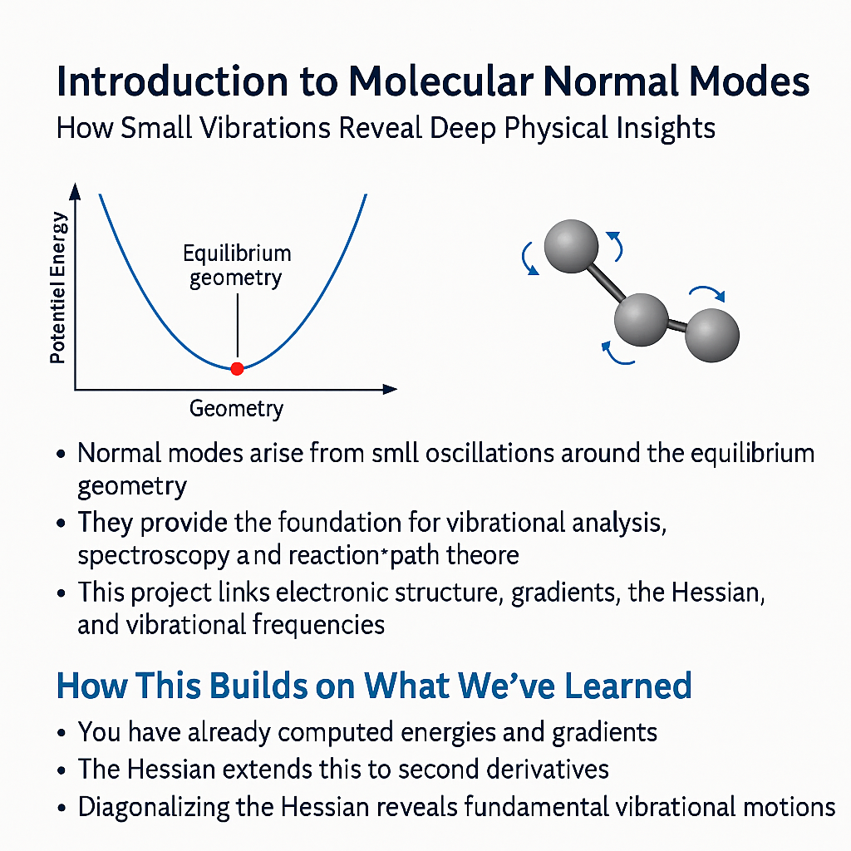

Slide 4
Normal Modes: Vibrational Analysis
Normal Modes = Independent Vibrational Patterns of a Molecule
Or simple solutions of a system of oscillators where all the degrees of freedom oscillate with the same frequency.
For a Given Molecule with N atoms there are 3N degrees of freedom
The number of normal modes equals:
For Nonlinear Molecules
3N - 6
For Linear Molecules
3N - 5

Slide 5
How Do We Obtain The Normal Modes?
Process to Compute the Normal Modes:
1. Optimize the molecular geometry
2. Compute the Hessian matrix
3. Convert to mass-weighted Hessian
4. Solve the eigenvalue problem
5. The eigenvalues are the frequencies
6. The eigenvectors are the normal mode displacement patterns

Slide 6
Geometry Optimization: Homework 5 extra credit
To optimize the geometry, we refactored the optimization code from homework 1 to be compatible with our CNDO/2 code.
Normal modes can only be computed once the molecule is fully optimized.
At the optimized geometry, moving any atom slightly in any direction increases the energy.

Slide 7
Linear Algebra Review
What are Eigenvectors and Eigenvalues?
Eigenvectors are nonzero vectors that, when a linear transformation is applied to it, results in a new vector that has the same direction as the original vector but a different magnitude.
Eigenvalues are scalars that scale the original vector into the new vector.

Slide 8
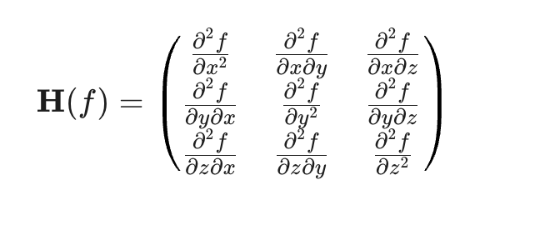
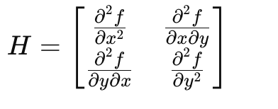
The Hessian Matrix
The second derivatives of the energy (in our case).
H for E = f(x,y) H for E = f(x,y,z)

Slide 9
What does the Hessian Do
The Hessian Matrix is a linear transformation that maps atomic displacements to restoring forces
In other words, the Hessian tells you how hard the energy pushes back if you displace an atom
The Hessian Matrix is a 3N x 3N matrix, where N is the number of Atoms
By diagonalizing (Solving the Eigenvalue Problem) we can determine the independent vibrational motions and their frequencies

Slide 10
Why is the Hessian 3N x 3N?
The Gradient Matrix could be represented as a 3N vector, where each atom has its x coordinate y coordinate, and z coordinate adjacent to each other as such:
[X0, Y0, Z0, X1, Y1, Z1, …, Xn-1, Yn-1, Zn-1]
To build the Hessian we take the second derivative of each atom with respect to each coordinate. Therefore we take the second derivative with respect to X0 with respect to X, Y, and Z.
As a result for every entry in the 3N vector we compute the second derivative with respect to all 3N coordinates, which form a 3N x 3N matrix

Slide 11
What do the normal modes of the Hessian represent
Each Eigenvector is a specific pattern of motion in a given direction, where the eigenvalue is the magnitude of the displacement in that direction
The eigenvalues of translational and rotational motion map those displacement to the zero vector
If all the atoms move in a way where the bond lengths remain constant the energy is does not change (rotational and translational invariance)
If an atom moves in a way that changes a bond length the energy increase and the intermolecular forces act to restore the molecule to the relaxed position

Slide 12
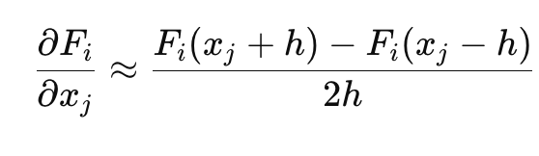
Central Difference Approximation
In Homework five we computed the first derivative of the Energy and stored it in our Gradient Matrix.
Since this matrix contained already contained the first derivatives of the energy, we could use finite differences to approximate the second derivative.

Slide 13
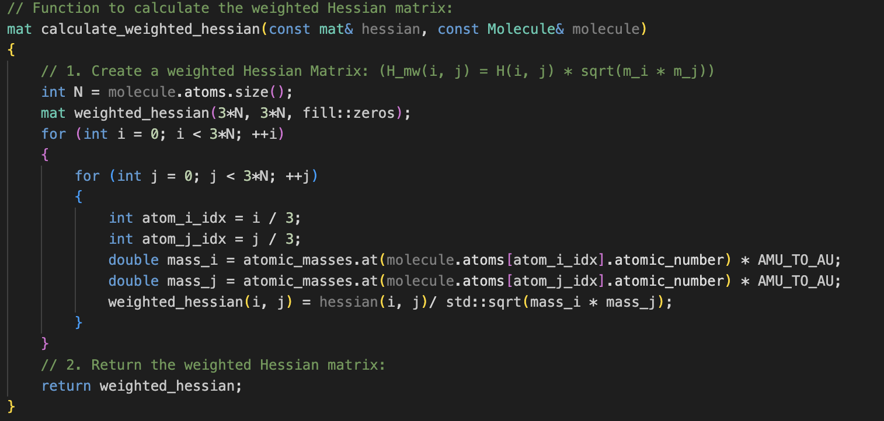
Convert to Mass Weighted Hessian

Slide 14
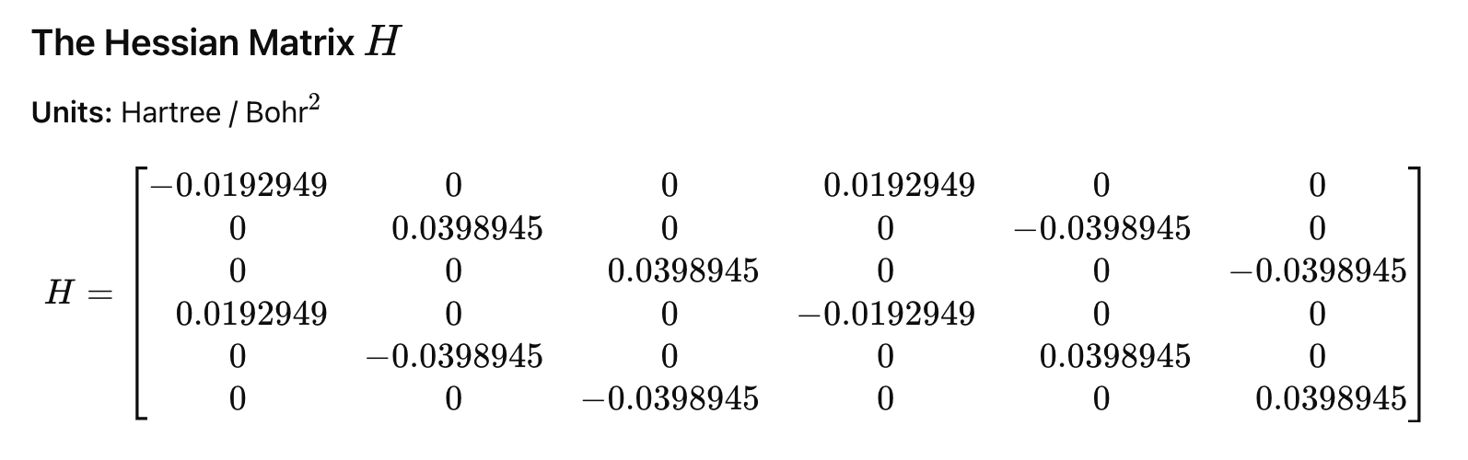
VERIFICATION STRATEGY: psi4

Slide 15
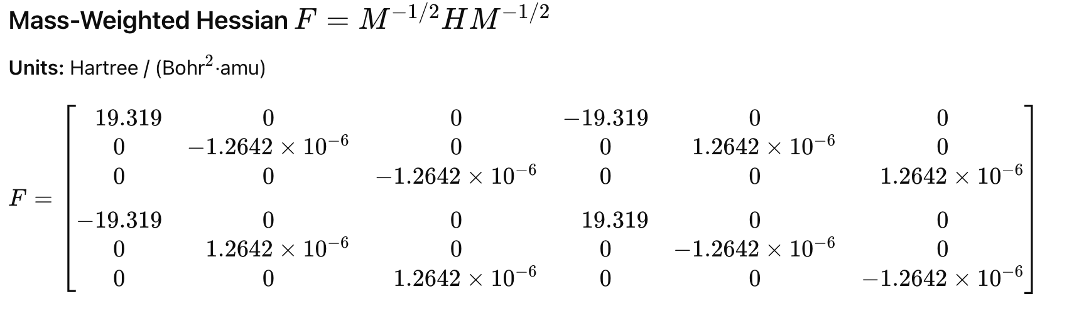
Versus Our Result

Slide 16
Solving The Eigenvalue Problem
Since the eigenvector represent the modes we are trying to visualize, we can leverage a linear algebra library to compute the eigenvectors.
The modes we are interested in will have none zero eigenvalues
If the geometry was not perfectly optimized we may get imaginary modes, which we will be able to tell because their eigenvalues will be negative.
Any eigenvectors with negative eigenvalues we will ignore.

Slide 17
Results: Normal Modes & Frequencies
Molecules – LINEAR | Frequencies (cm⁻¹) | Experimental values (cm⁻¹) | Error (%)
H₂ | Mode 1: 0 Mode 2: 0 Mode 3: 0 Mode 4: 0 Mode 5: 0 Mode 6: 6126.37 | 4401 | 39.2
HF | Mode 1: 0 Mode 2: 0 Mode 3: 0 Mode 4: 0 Mode 5: 0 Mode 6: 6094.76 | 4138 | 47.3
HO | Mode 1: 0 Mode 2: 0 Mode 3: 0 Mode 4: 0 Mode 5: 0 Mode 6: 5703.66 | 3737 | 52.6

Slide 18
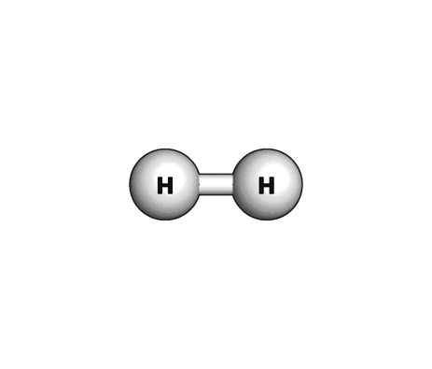
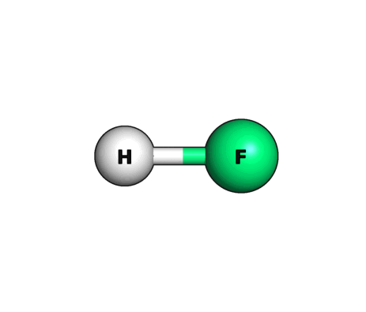
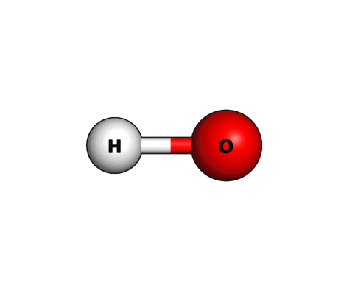
Visualization: Linear Molecules
Molecule: H₂ (N = 2)
Molecule: HF (N = 2)
Molecule: HO (N = 2)
H-H Bond Stretch
Mode 6: 6126.37 cm⁻¹
H-F Bond Stretch
Mode 6: 6094.76 cm⁻¹
H-O Bond Stretch
Mode 6: 5703.66 cm⁻¹

Slide 19
Visualization: Linear Molecules
Molecule: H₂ (N = 2)
Molecule: HF (N = 2)
Molecule: HO (N = 2)
H-H Bond Stretch
Mode 6: 6126.37 cm⁻¹
H-F Bond Stretch
Mode 6: 6094.76 cm⁻¹
H-O Bond Stretch
Mode 6: 5703.66 cm⁻¹

Slide 20
Results: Normal Modes & Frequencies
Molecules – NON LINEAR | Frequencies (cm⁻¹) | Experimental values (cm⁻¹) | Error(%)
H₂O [3 Atom Molecule] | Mode 1: 0 Mode 2: 0 Mode 3: 0 Mode 4: 0 Mode 5: 0 Mode 6: 0 Mode 7: 1766.42 Mode 8: 5679.51 Mode 9: 5694.04 | 1595 3657 3756 | 10.74 55.3 51.6

Slide 21
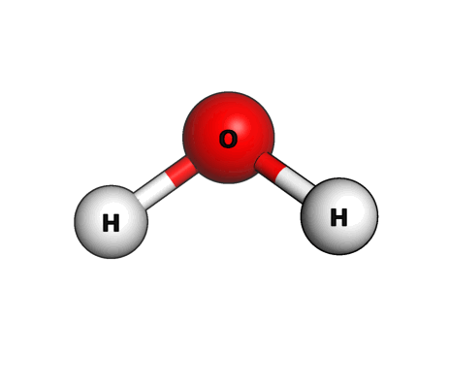
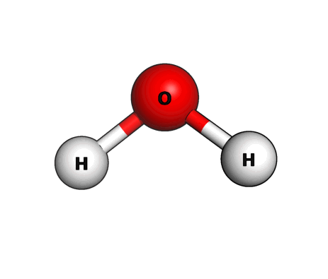
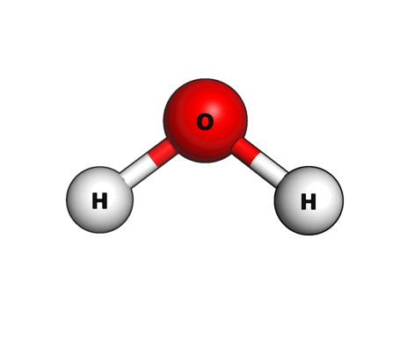
Visualizations: Non-linear Molecules
Molecule: H₂O (N = 3)
Symmetric Bend
Mode 7: 1766.42 cm-1
Symmetric Stretch
Mode 8: 5679.51 cm⁻¹
Asymmetric Stretch
Mode 9: 5694.04 cm⁻¹

Slide 22
Results: Normal Modes & Frequencies
Molecules – NON LINEAR | Frequencies (cm⁻¹) | Experimental values (cm⁻¹) | Error(%)
NH₃ [4 Atom Molecule] | Mode 1: 0 Mode 2: 0 Mode 3: 0 Mode 4: 0 Mode 5: 0 Mode 6: 0 Mode 7: 1506.12 Mode 8: 1778.95 Mode 9: 1779.13 Mode 10: 5225.6 Mode 11: 5264.05 Mode 12: 5264.13 | 950 1627 3337 3414 | 58.5 9.33 9.35 56.6 54.19 54.19

Slide 23
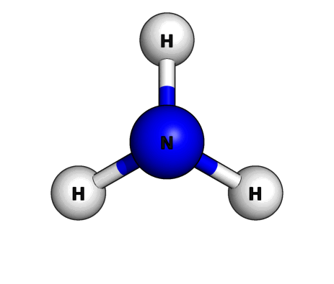


Visualizations: Non-linear Molecules
Molecule: NH₃ (N = 4)
Symmetric Bend
Mode 7: 1506.12 cm-1
Asymmetric Bend
Mode 8: 1778.95 cm-1
Asymmetric Bend
Mode 9: 1779.13 cm-1

Slide 24



Visualizations: Non-linear Molecules
Molecule: NH₃ (N = 4)
Symmetric Stretch
Mode 10: 5225.6 cm-1
Asymmetric Stretch
Mode 11: 5264.05 cm-1
Asymmetric Stretch
Mode 12: 5264.13 cm-1

Slide 25
Results: Normal Modes & Frequencies
Molecules – NON LINEAR | Frequencies (cm⁻¹) | Experimental values (cm⁻¹) | Error(%)
CH₄ [5 Atom Molecule] | Mode 1: 0 Mode 2: 0 Mode 3: 0 Mode 4: 0 Mode 5: 0 Mode 6: 0 Mode 7: 1648.43 Mode 8: 1648.43 Mode 9: 1648.43 Mode 10: 1760.53 Mode 11: 1760.53 Mode 12: 4837.61 Mode 13: 4950.33 Mode 14: 4950.33 Mode 15: 4950.33 | 1380 1412 3215 3104 | 19.45 24.68 50.46 59.48

Slide 26
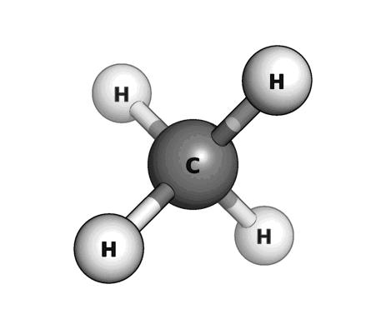


Visualization continued:
Molecule: CH₄ (N = 5)
A triply degenerate bend due to geometry
Asymmetric bend
Mode 7: 1648.43 cm-1
Asymmetric bend
Mode 8: 1648.43 cm-1
Asymmetric bend
Mode 9: 1648.43 cm-1

Slide 27


Visualization continued:
Molecule: CH₄ (N = 5)
Symmetric bend
Mode 10: 1760.53 cm-1
Symmetric bend
Mode 11: 1760.53 cm-1
Symmetric Stretch
Mode 12: 4837.61 cm-1

Slide 28



Visualization continued:
Molecule: CH₄ (N = 5)
A triply degenerate stretch due to geometry
Asymmetric stretch
Mode 13: 4950.33 cm-1
Asymmetric stretch
Mode 14: 4950.33 cm-1
Asymmetric Stretch
Mode 15: 4950.33 cm-1

Slide 29
Observations & Interpretations
Observations: Zero Modes in Linear vs. Non-Linear Molecules
Linear molecules (H₂, HF), the first 5 modes are consistently 0 cm⁻¹
Non-linear molecules (H₂O, NH₃), the first 6 modes are consistently 0 cm⁻¹
Interpretation:
Zero values represent Translational (moving through space) & Rotational (spinning) modes
When molecules rotate or drifts freely in space, bond lengths and angles do not change. Hence, if there’s no change in potential energy, the force constant is zero, resulting in zero frequency
Fundamental degrees of freedom: linear molecules cannot rotate around their own axis, losing 1 rotational degree of freedom (3N - 5) compared to non-linear molecules (3N-6)
Notes:
Why Zero? A vibration requires a restoring force (like a spring pulling back). When a molecule rotates or drifts freely, bond lengths and angles do not change. Since there is no change in potential energy, the "force constant" is zero, resulting in a frequency of zero.

Slide 30
Observations & Interpretations
Observation: Distinction Between Low and High Frequency Modes
The bending modes, such as H₂O [~1766 cm⁻¹], NH₃ [~1506 cm⁻¹], and CH₄ [~1648 cm⁻¹] are significantly lower than their stretching counterparts.
Interpretation:
These modes correspond to the bending or deformation motion (“umbrella” inversion of Ammonia, or the “scissoring” of water).
Geometrically, it requires less energy to change a bond angle than to stretch a bond length.
The high values indicate “stiff” chemical bonds. To stretch atoms and break these bonds, it requires significant energy, resulting in high oscillations frequencies
In physical terms, the lower frequencies indicate that “the springs” controlling the angles are looser than the “springs” controlling bond distances

Slide 31
Observations & Interpretations
Observation: Symmetry in Ammonia and Methane
For Ammonia, we observe distinct pairs of identical frequencies (e.g., Modes 7 & 8, as well as Mode 10 & 11)
For Methane, we observe sets of similar frequencies [Asymmetric motions], as well as distinct frequencies mode 12 [symmetric motion]
Interpretation:
Ammonia & methane are interesting molecules, which involves symmetry fingerprint → These closely identical values represent degeneracy. Due to Ammonia’s triangular symmetry & methane tetrahedral geometry, the motion of “Hydrogen A” is indistinguishable from “Hydrogen B”. The code correctly realizes that these distinct motion require the same exact amount of energy for their motion.

Slide 32
Results vs. Experimental values → Error Analysis
Interpretation of frequency accuracy:
All calculated frequencies consistently overestimated experimental values for both linear and non-linear molecules
Linear molecules deviations ranging from 39.2% to 52.6%
Non-linear stretching modes had higher deviations ~51 - 55%
“Stiffness” of the model:
The overestimation is an indication of the use of a “stiff” theoretical model such as Hartree-Fock with a minimal basis set
The model restricts electron flexibility, hence creating steeper potential energy well than reality. A steeper well corresponds to a stiffer spring, resulting in higher calculated frequencies
Bending vs. Stretching:
The bending mode of H₂O had only a 10.74% error and NH₃ asymmetric bends had ~9.3% error → the basis set captures angular changes well, but fails to describe bond elongation for stretching modes

Slide 33
Limitations
Vibrational Analysis Relies On Optimized Structures.
One of the limitations we ran into is our geometry optimizer is not perfect and doesn’t always find the true minimum energy structure
In those cases our normal mode calculations are not accurate
Another issues is that our upstream code only generates basis functions for certain atoms. Our code therefore will not compute the normal modes (or do any of the other things) for molecules contain sulfur or phosphorus for instance

Slide 34
Conclusion
Project success
Developed a high-performance C++ module that automates the pipeline from molecular geometry optimization to normal mode analysis & visualization
Mathematical robustness
Module able to distinguish and handle correctly linear & non-linear degrees of freedom
Eigenvalues were overestimated due to theory limitations, the eigenvectors (the shapes of vibrations shown in the slides) are physically correct and maintained degeneracy
Computational Efficiency
By integrating the backend calculations with visualization file generation, the module facilitates the analysis workflow compared to manual parsing of the log files
Future work
As seen, frequency overestimation is a byproduct of limited quantum mechanical approximations in Hartree-Fock. Future implementations could involve using Density Functional Theory (DFT) to bring the frequency values closer to experimental data

Slide 35
References
Experimental frequencies: https://www.chem.purdue.edu/jmol/vibs/
CHEM-279 Lecture materials
Code Review & Troubleshooting: Google Gemini Pro

Slide 36
CODEBASE STRUCTURE
CHEM-279-FINAL-PROJECT/
├── CMakeLists.txt // Main build configuration
├── Dockerfile // Environment definition
├── README.md // Short description of the project and guide the user to run
├── data/ // Sample input files (XYZ coords)
├── src/ // Source files (.cpp)
│ ├── main.cpp // Main file to run the process
│ ├── Analyzer.cpp // Module to compute the Modes (mass-weighted Hessian Matrix & Eigenproblem solver)
│ └── Writer.cpp // Module to write the .xyz & .pdb files to be run on Avogadro & PyMol
├── include/ # Header files (.h)
│ ├── Analyzer.h
│ └── Writer.h
└── tests/ # Future work: Unit tests
└── test_basic.cpp // Module to perform some basic tests
// We can set up github actions that run automatically.

Slide 37
This Slide We will Delete: Plan for slideshow
Introduction to topic - how it builds on what we have learned in the course
What is a Normal Mode and Why Are the useful (Most Important!!)
How do we calculate the normal modes
Code snippet
Symmetric mode
Asymmetric mode
Bend mode
Numerical results
Comparison to professional code
Conclusion

Slide 38
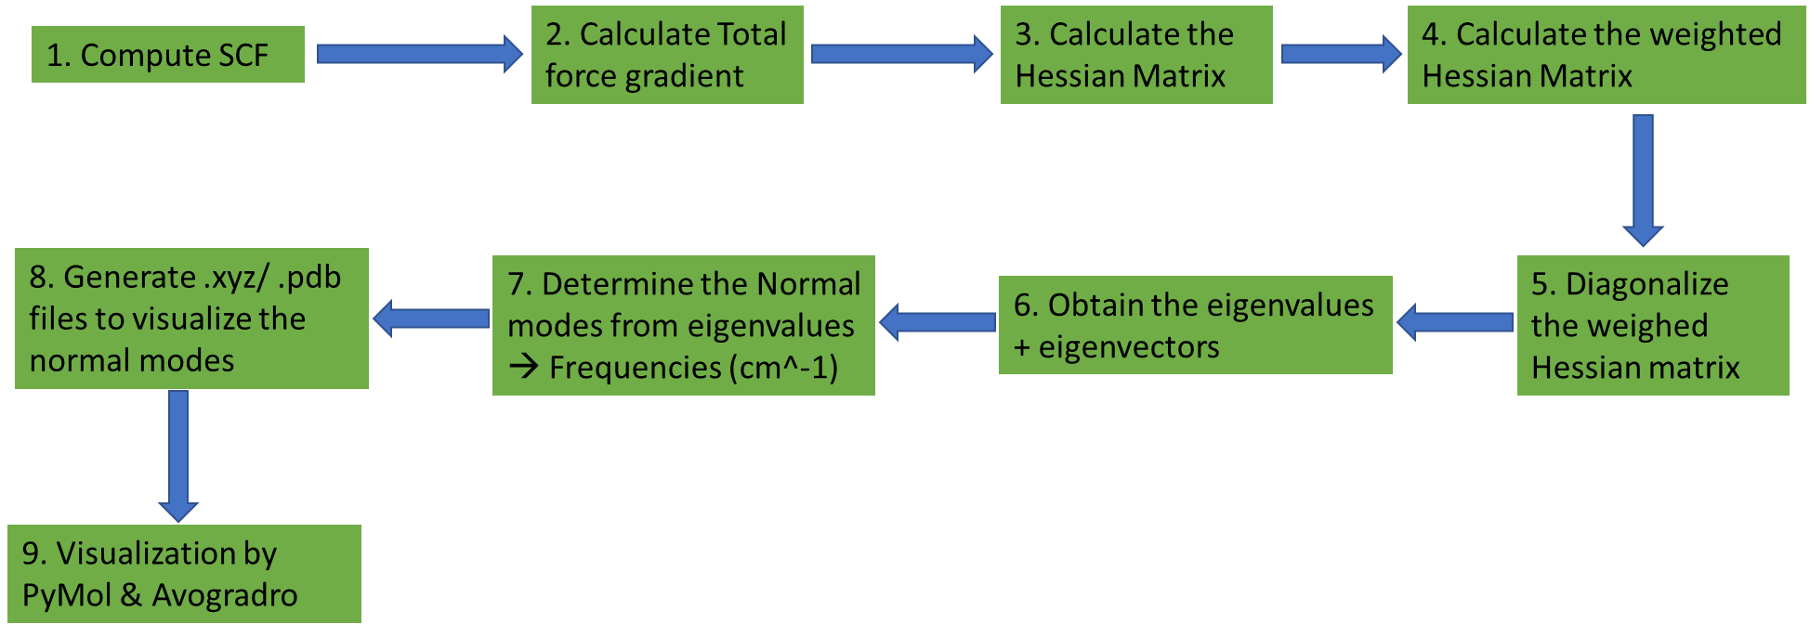
IMPLEMENTATION PROCESS FLOW

Slide 39
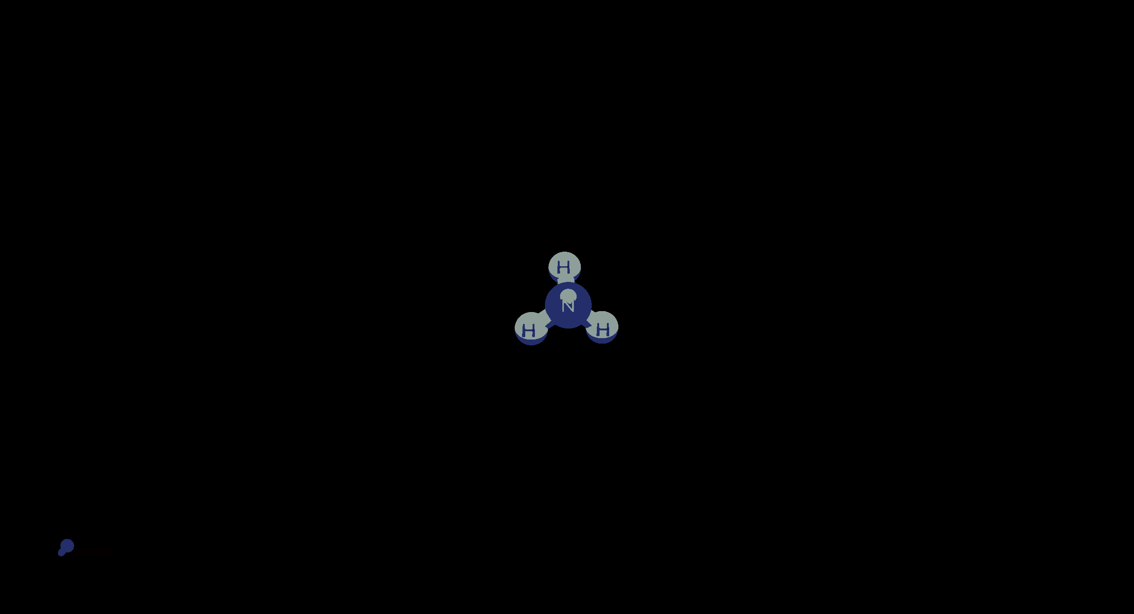
NH3 Mode 6 (or 1 depending on how you count)

Slide 40
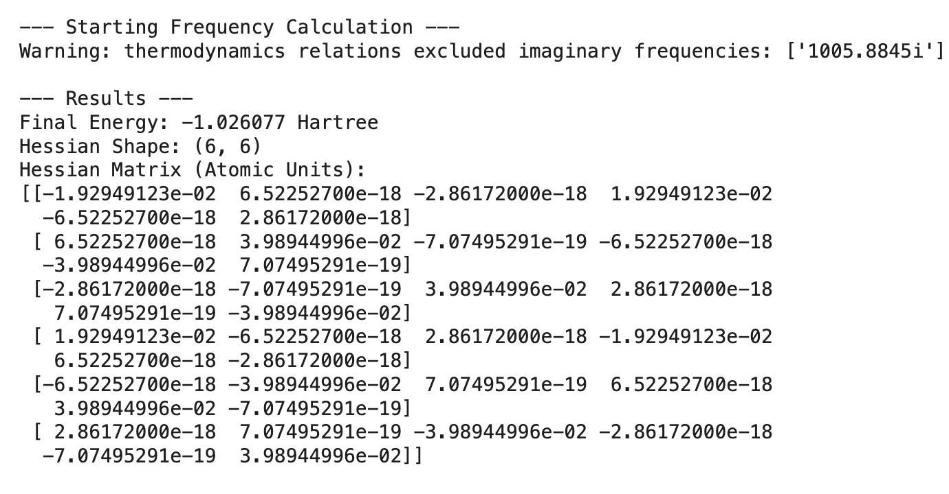
VERIFICATION STRATEGY
We will use professional software to compare our results.
For instance: using psi4 on provided H2 inputs gave:

Slide 41
OVERVIEW
Analyzing normal modes is essential task to understand the complex and coupled motions of atoms in a molecule into simple and independent vibrations.
Normal modes: describe how atoms move following a specific pattern of vibration where each atom oscillate with the same frequency, as it passes through the equilibrium position. → Eigenvectors containing the displacement (x,y,z) of every atom.
Frequencies: describes how fast that specific pattern oscillates (how much energy it costs to make that movement) → Eigenvalues.
Goal: C++ module that computes raw calculations and visualization through Avogrado & || VMD.

Slide 42
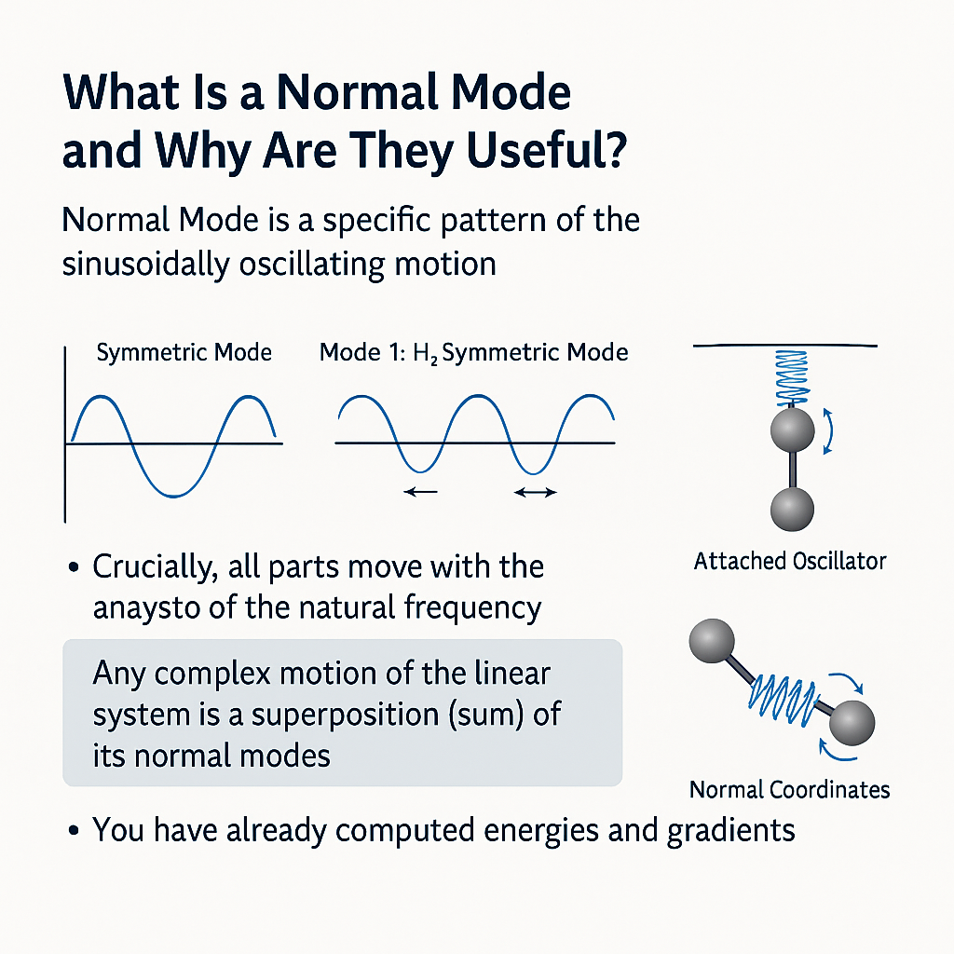

Slide 43
KEY COMPONENTS
HW5 Code: molecular system & SCF algorithm
Final Project:
Compute Hessian Matrix (Mass Weighted)
Diagonalize Hessian Matrix
Solve Eigenvalue Problem
Produce .xyz Files
Display Results

Slide 44
CODEBASE STRUCTURE
CHEM-279-FINAL-PROJECT/
├── CMakeLists.txt // Main build configuration
├── Dockerfile // Environment definition
├── README.md // Short description of the project and guide the user to run
├── data/ // Sample input files (XYZ coords)
├── src/ // Source files (.cpp)
│ ├── main.cpp // Main file to run the process
│ ├── Analyzer.cpp // Module to compute the Modes (mass-weighted Hessian Matrix & Eigenproblem solver)
│ └── Writer.cpp // Module to write the .xyz & .pdb files to be run on Avogadro & PyMol
├── include/ # Header files (.h)
│ ├── Analyzer.h
│ └── Writer.h
└── tests/ # Future work: Unit tests
└── test_basic.cpp // Module to perform some basic tests
// We can set up github actions that run automatically.

Slide 45
PRELIMINARY RESULTS
Molecules | Frequencies (cm⁻¹) | Experimental values (cm⁻¹) | Overestimation
H₂ | Mode 0: 0 cm⁻¹ Mode 1: 0 cm⁻¹ Mode 2: 0 cm⁻¹ Mode 3: 0 cm⁻¹ Mode 4: 0 cm⁻¹ Mode 5: 5510.09 cm⁻¹ | 4401 | +25%
H₂O | Mode 0: 0 cm⁻¹ Mode 1: 0 cm⁻¹ Mode 2: 0 cm⁻¹ Mode 3: 0 cm⁻¹ Mode 4: 0 cm⁻¹ Mode 5: 0 cm⁻¹ Mode 6: 793.289 cm⁻¹ Mode 7: 3134.01 cm⁻¹ Mode 8: 3632.26 cm⁻¹ | 1595 3657 3756 | -50.2% -14.3% -3.29%
HF | Mode 0: 0 cm⁻¹ Mode 1: 0 cm⁻¹ Mode 2: 0 cm⁻¹ Mode 3: 0 cm⁻¹ Mode 4: 0 cm⁻¹ Mode 5: 6087.72 cm⁻¹ | 4138 | +47%
HO | Mode 0: 0 cm⁻¹ Mode 1: 0 cm⁻¹ Mode 2: 0 cm⁻¹ Mode 3: 0 cm⁻¹ Mode 4: 0 cm⁻¹ Mode 5: 5694.14 cm⁻¹ | 3737 | +52%

Slide 46
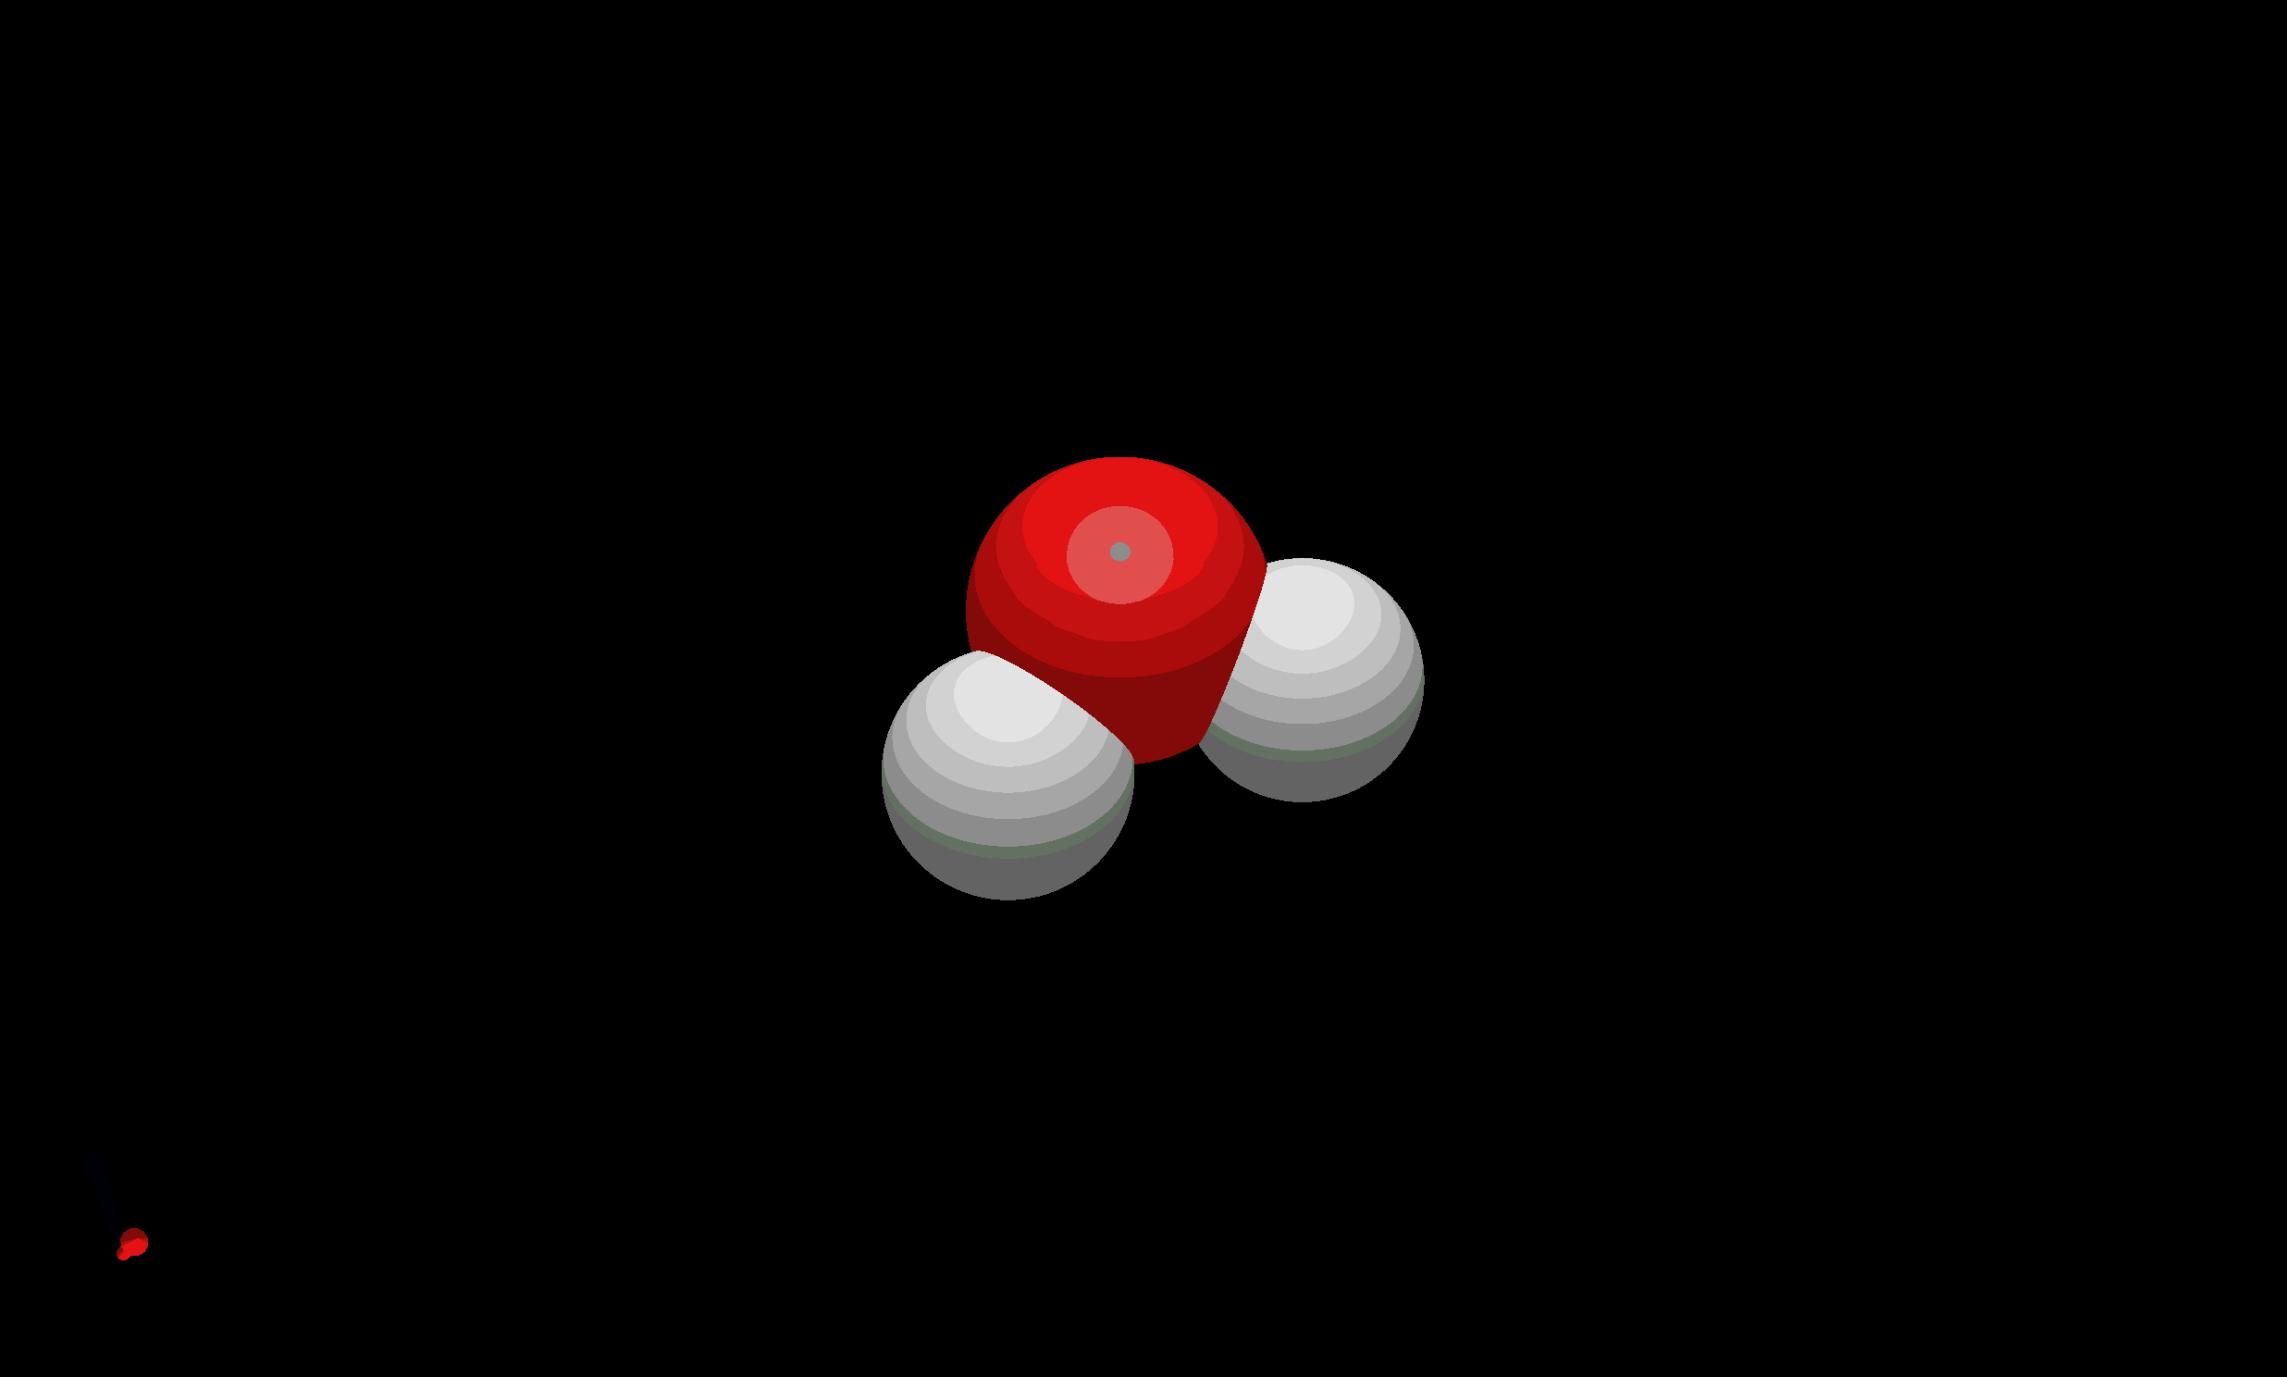
Mode 7: Bend Mode (Scissors)

Slide 47


Slide 48
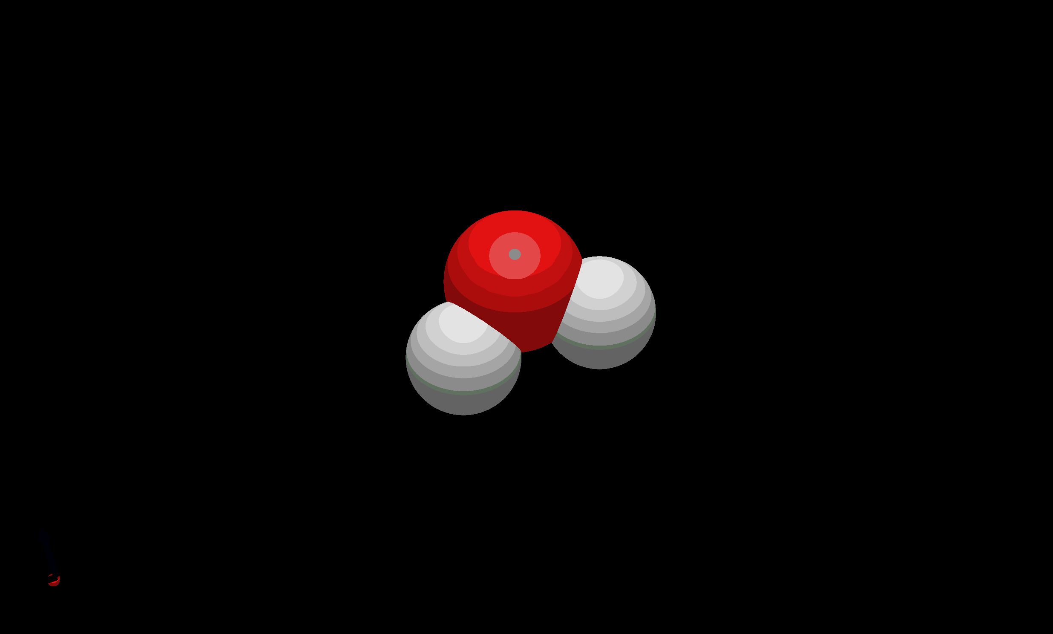
Mode 8: Symmetric Mode

Slide 49
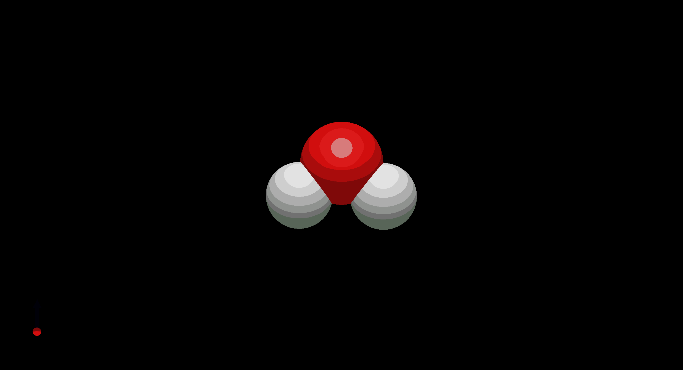
Mode 9: Asymmetric Mode

Slide 50
NEXT STEPS
Interpret the results (CNDO/2 model) & compare it with experimental values (IR Spectroscopy) to evaluate the trends.
Extend the implementation to evaluate other molecules not provided in the homework.
Complete the visualization model to be able to visualize the normal modes with Avogadro & VMD.
Develop test cases & Github actions to evaluate the model to avoid any crashes prior to utilization of the model.

Slide 51
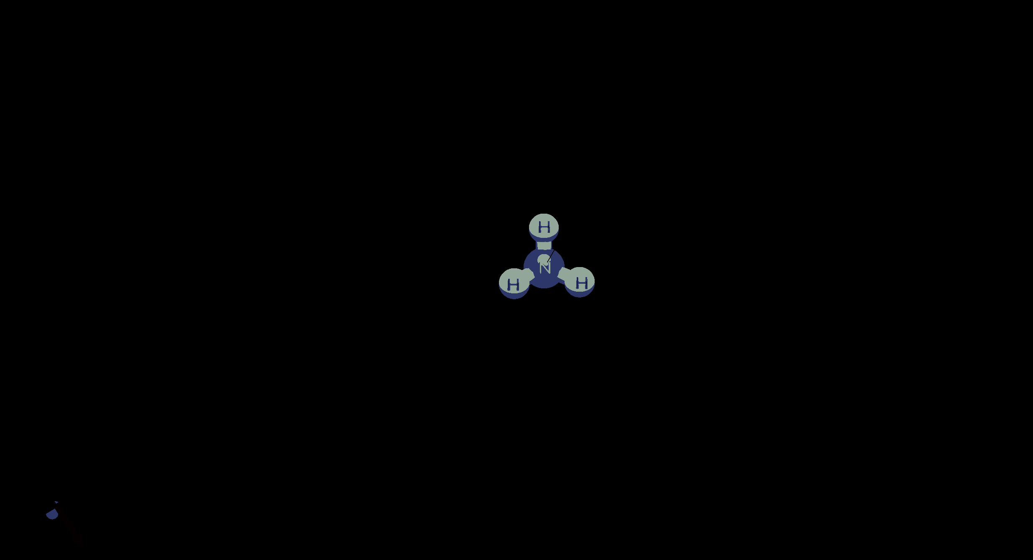
NH3 Mode 7:

Slide 52
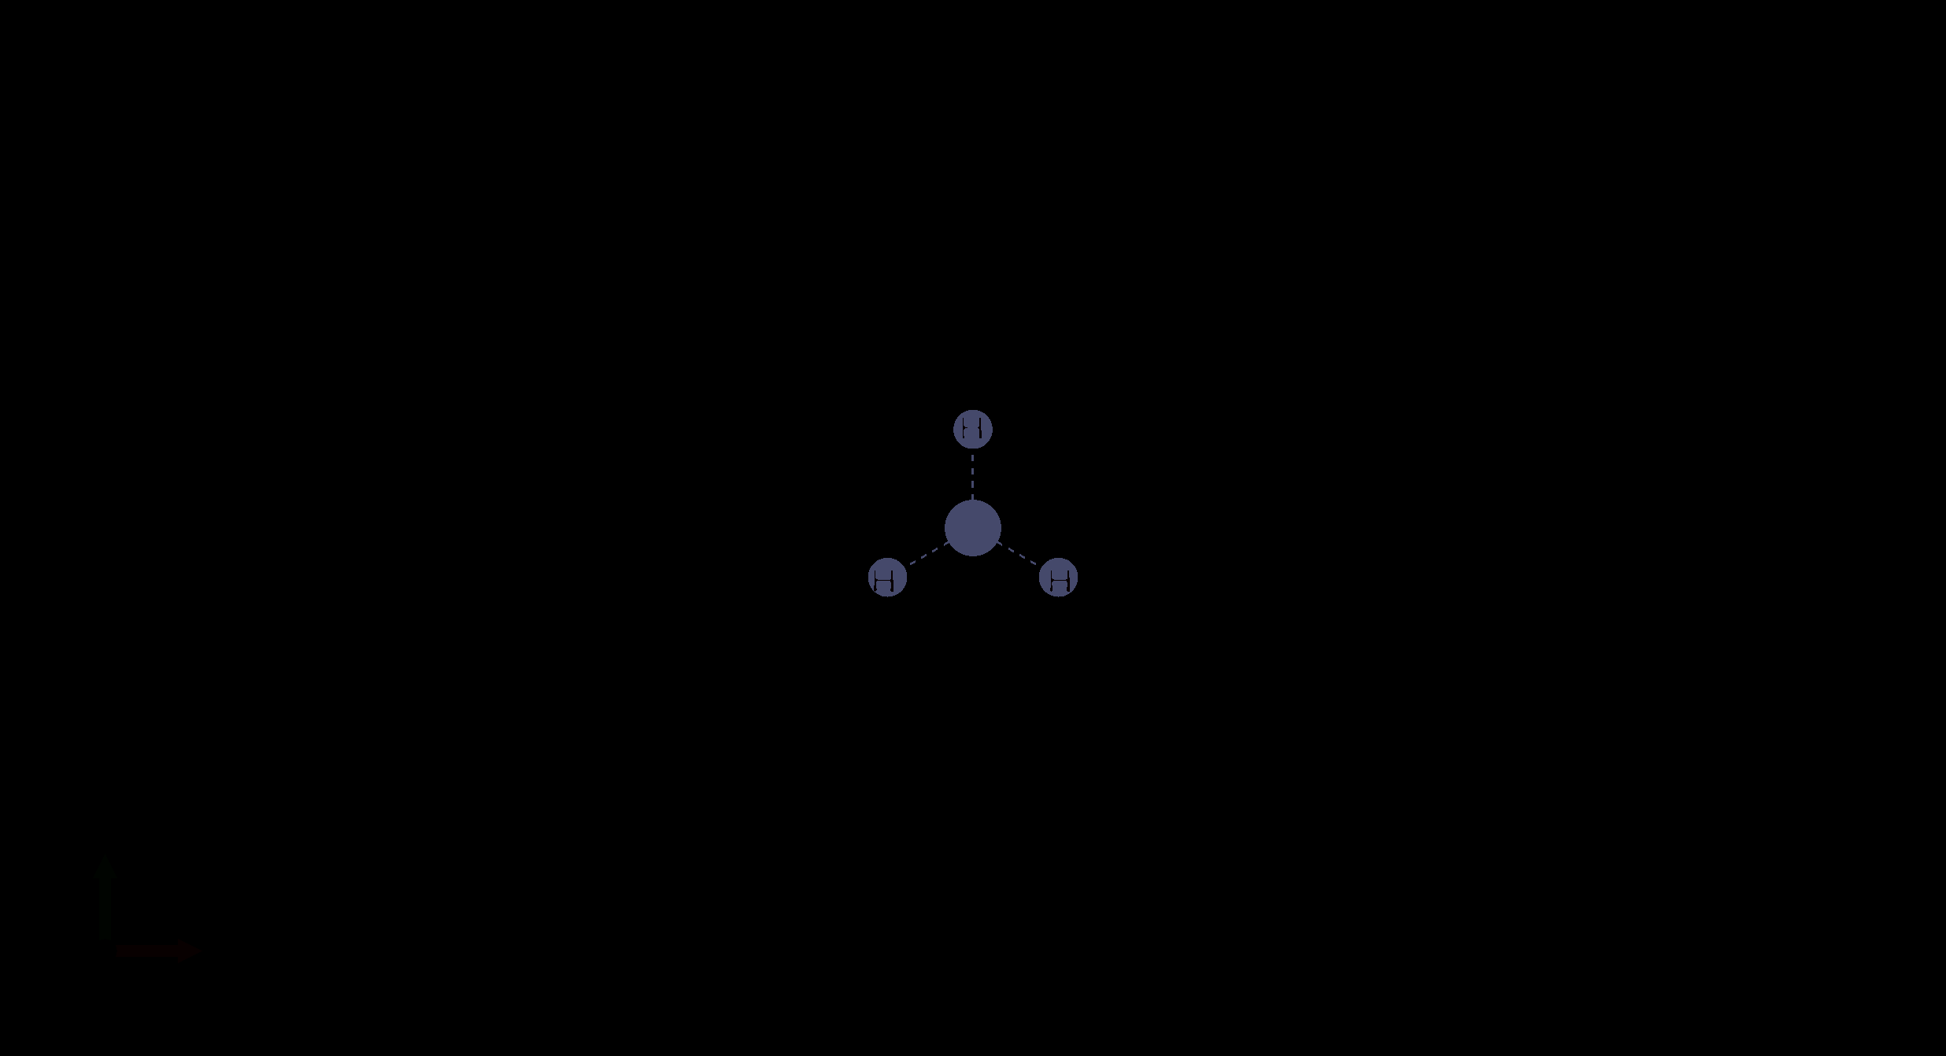
NH3 Mode 7 in Bohr

Slide 53
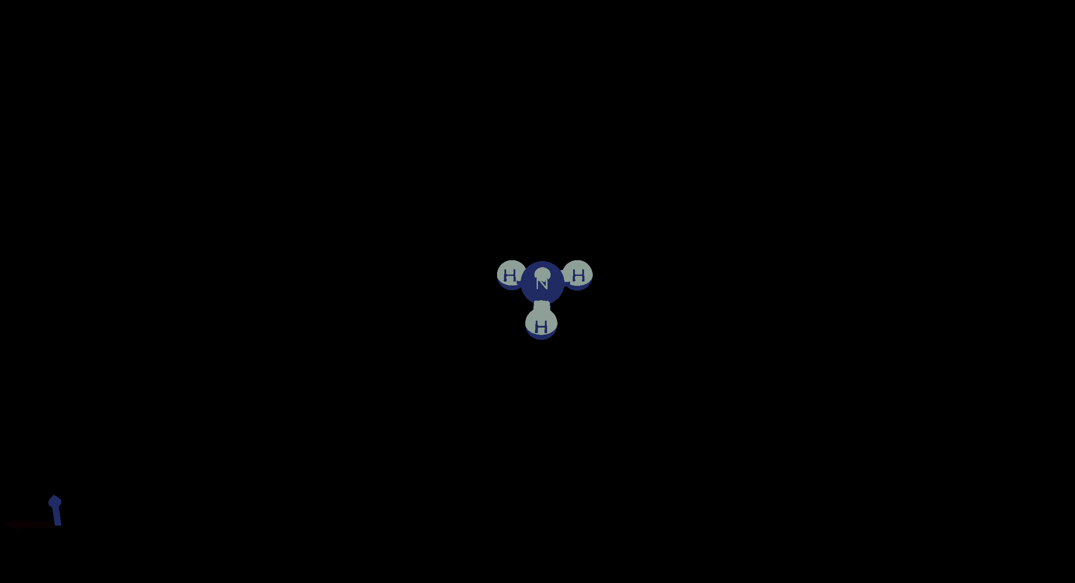
NH3 Mode 8:

Slide 54
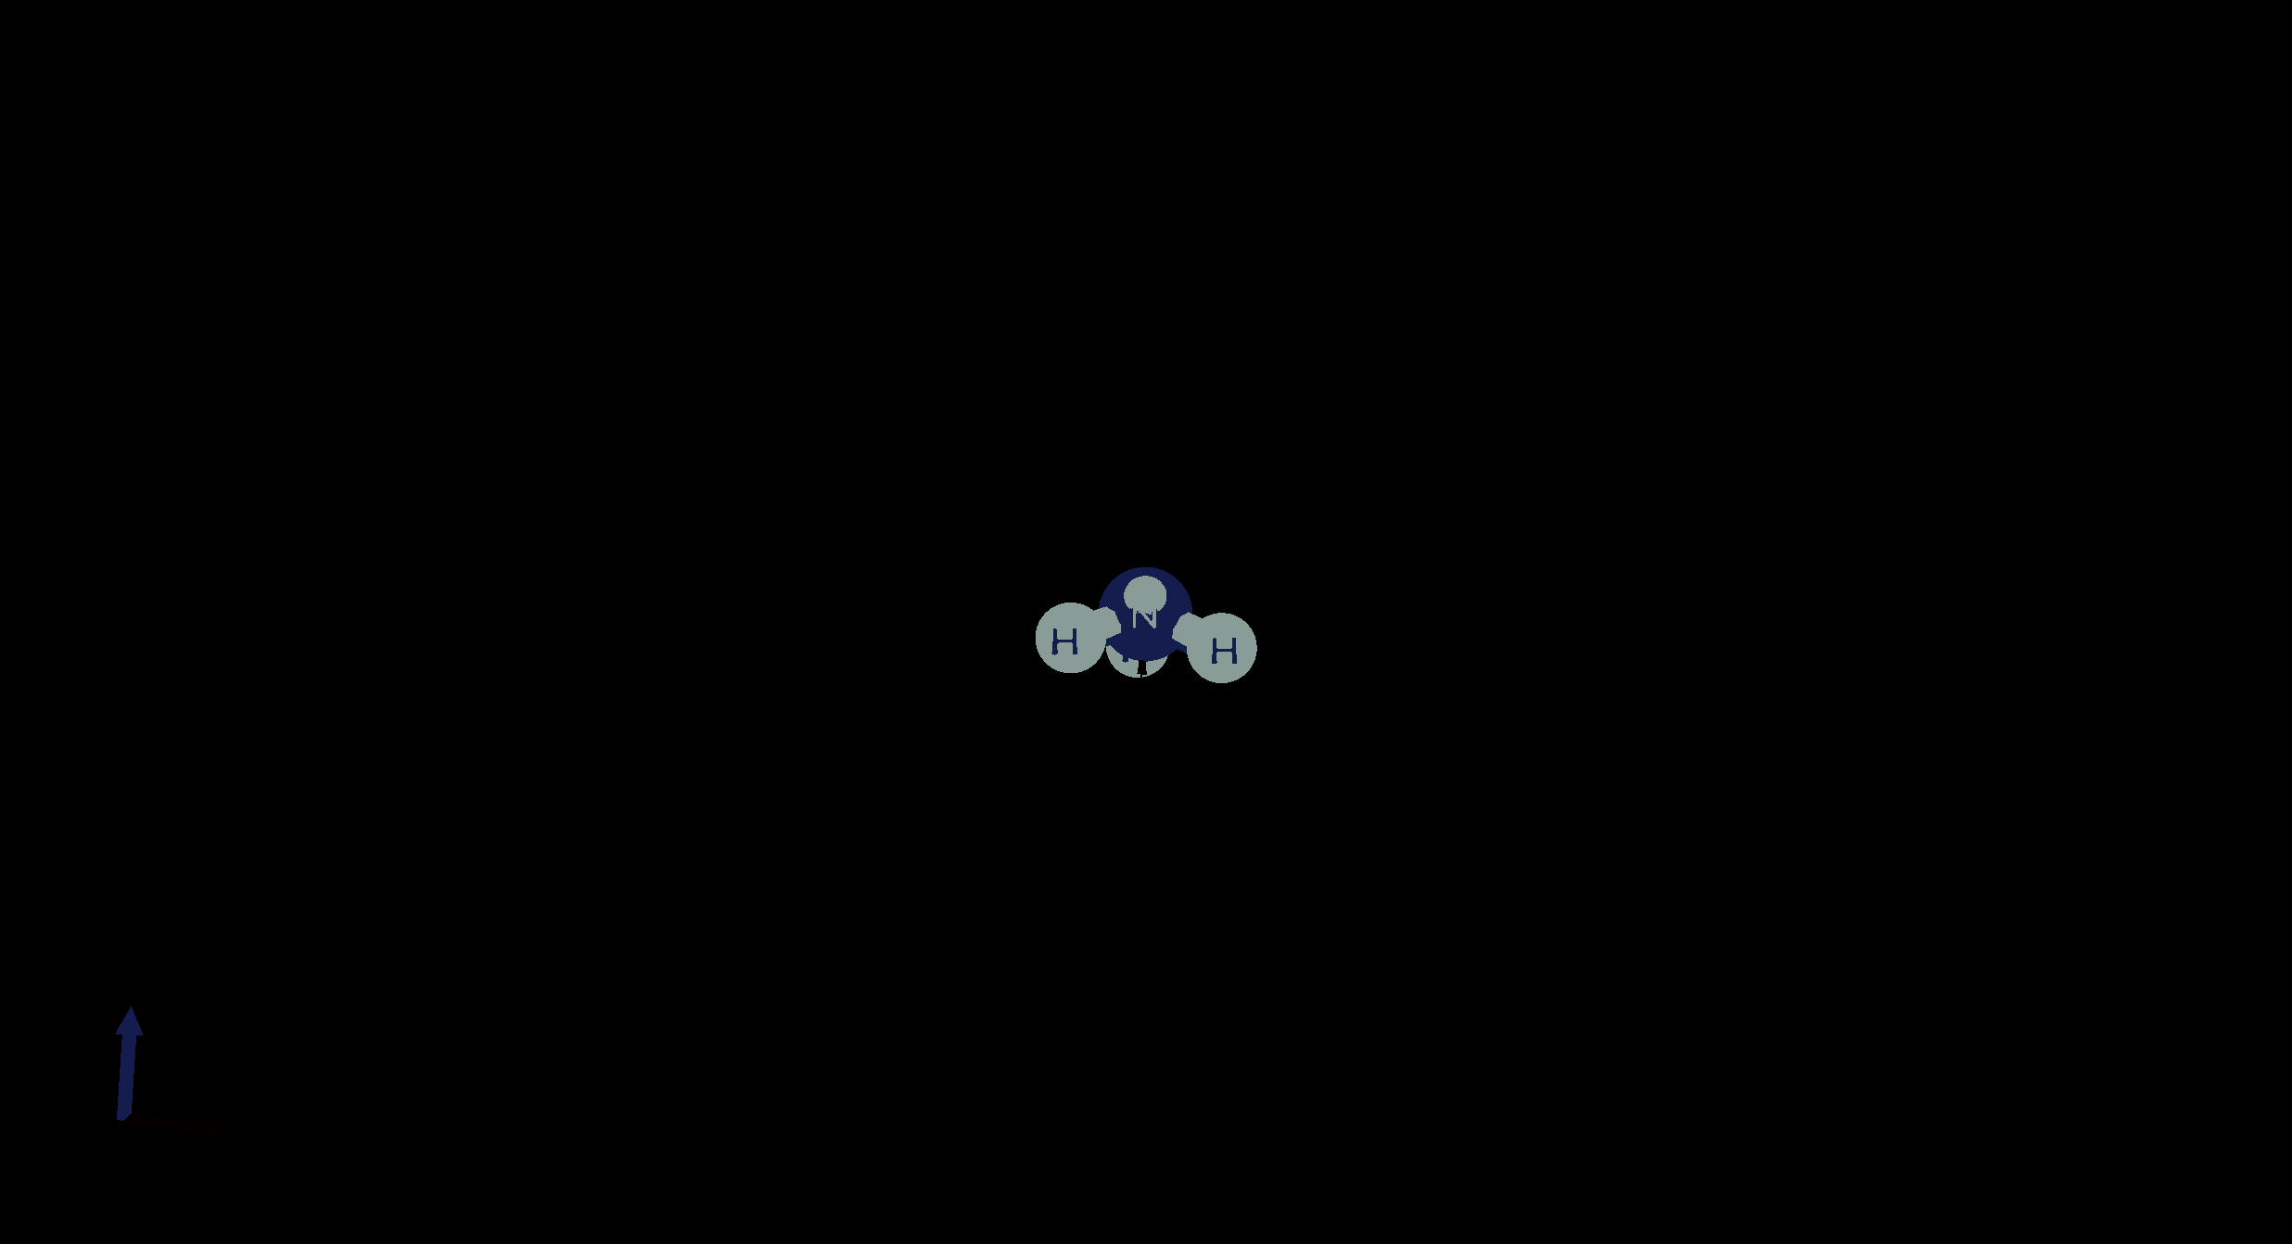
NH3 Mode 9

Slide 55
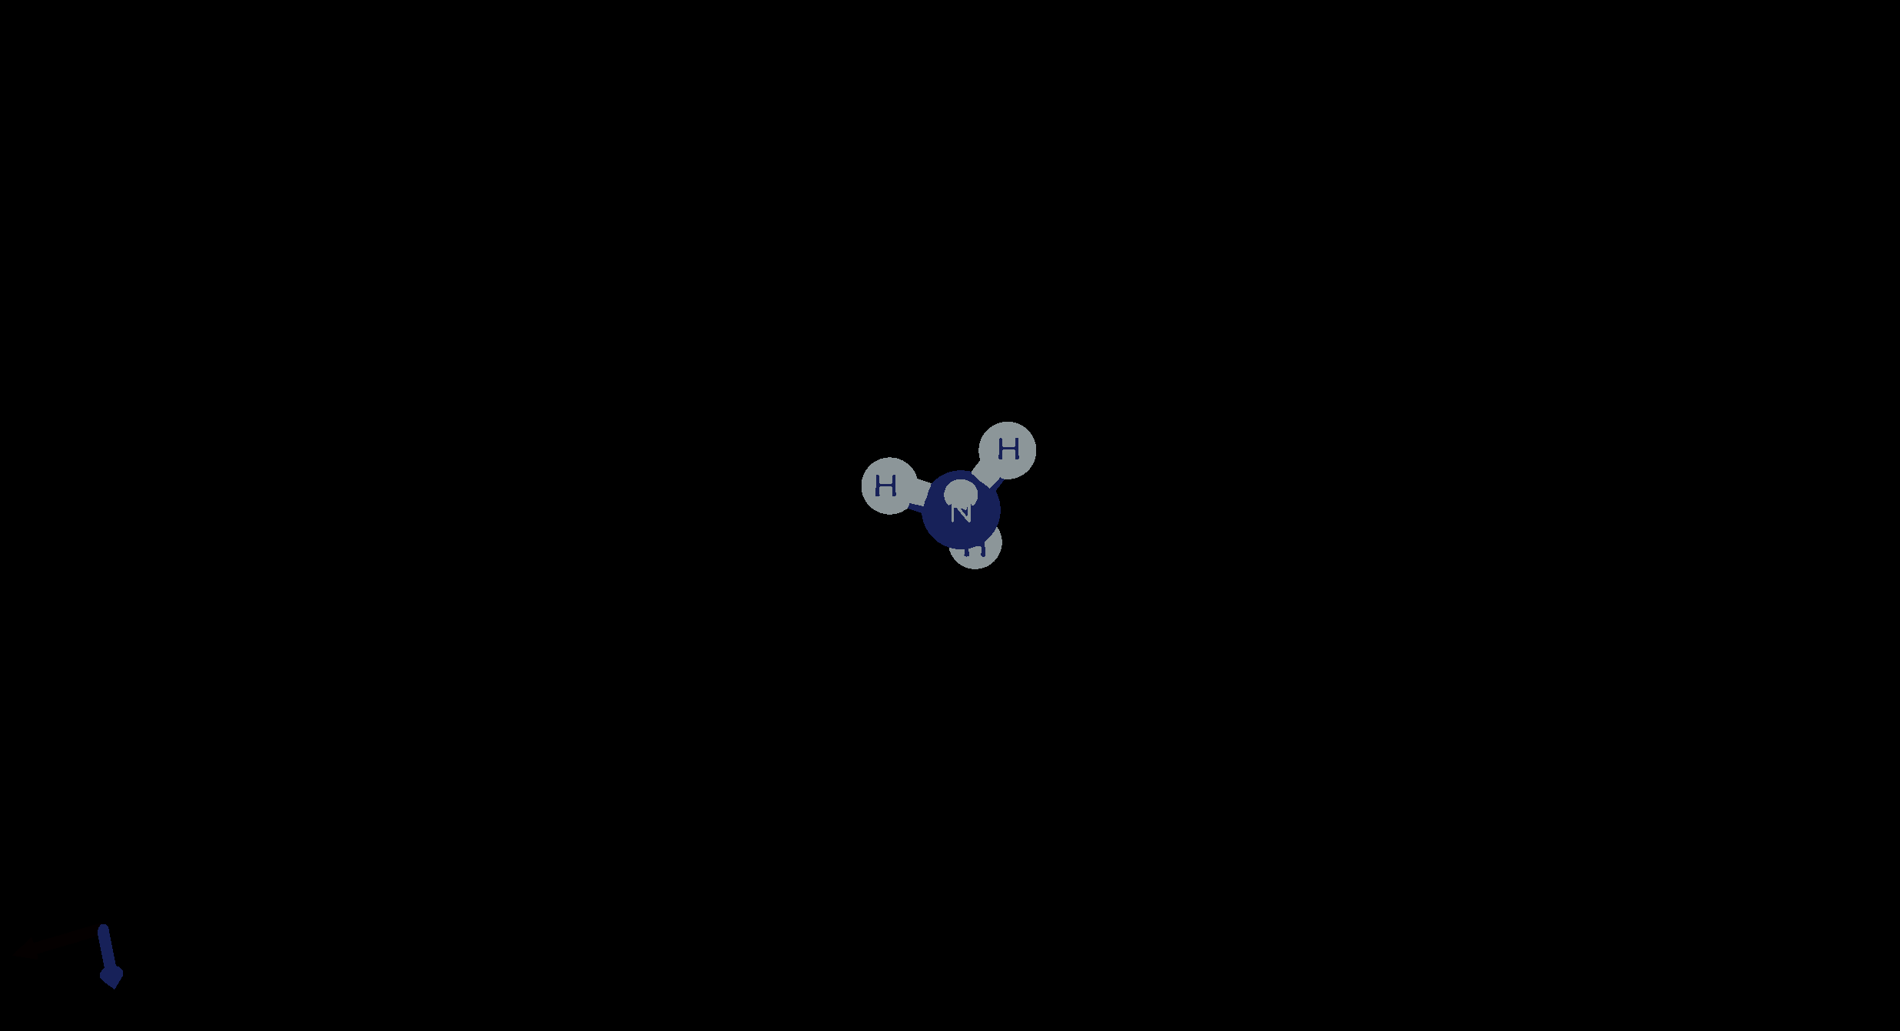
NH3 Mode 10

Slide 56
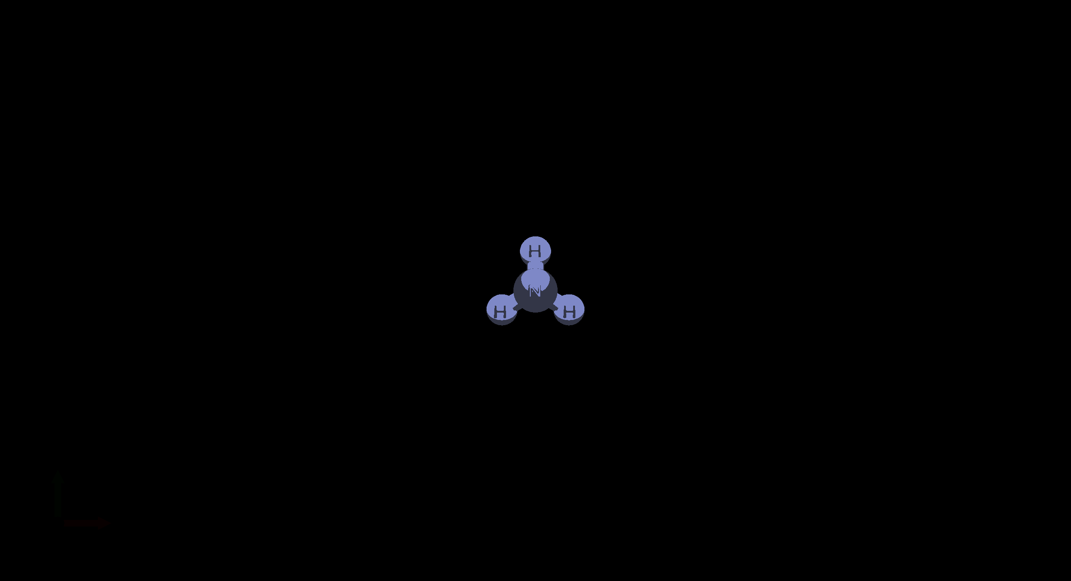
NH3 Mode 11

Slide 57
NH3 Mode 12

Slide 58
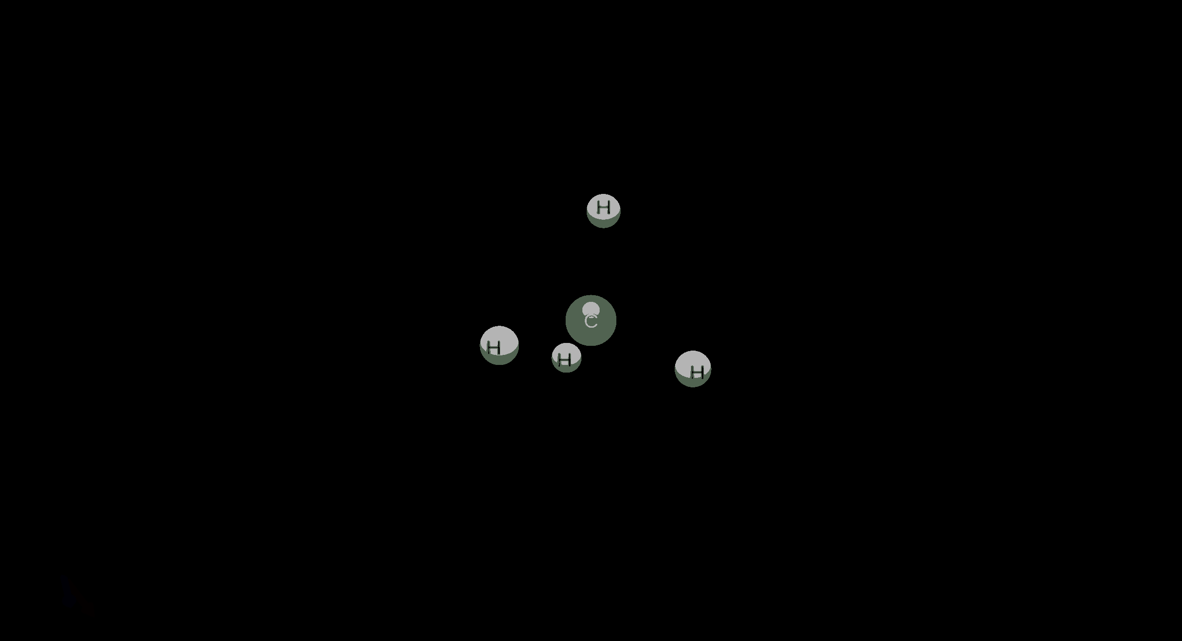
CH4 Mode 7

Slide 59
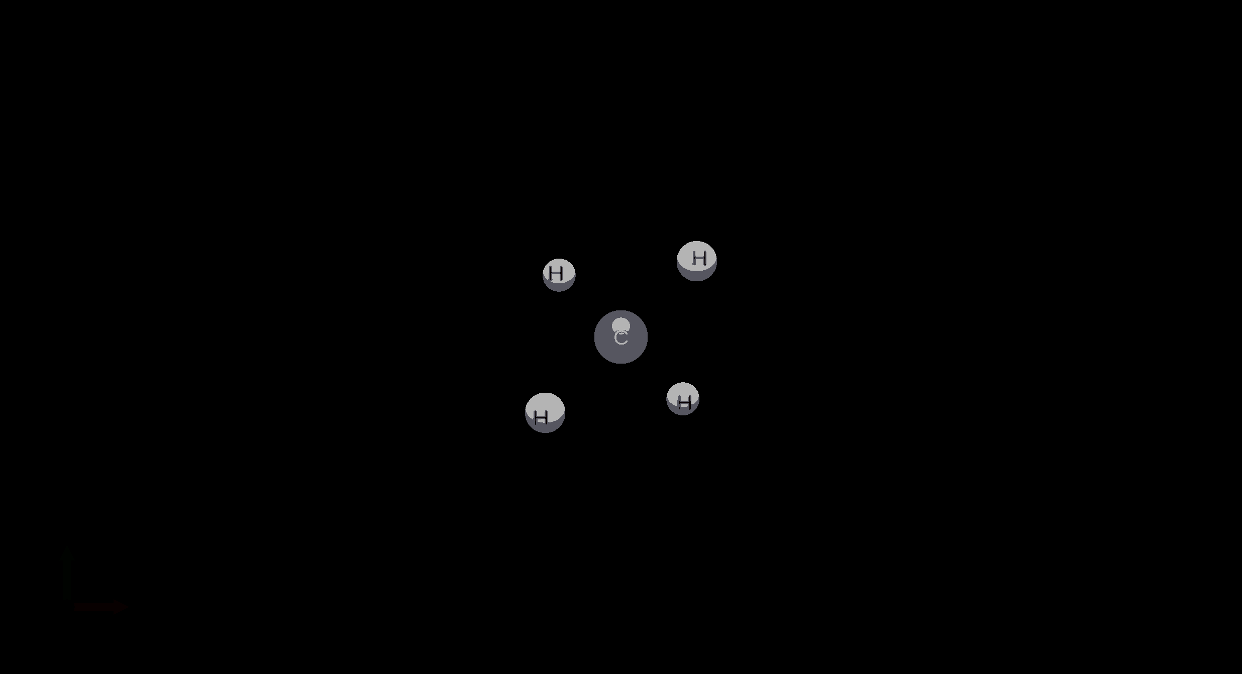
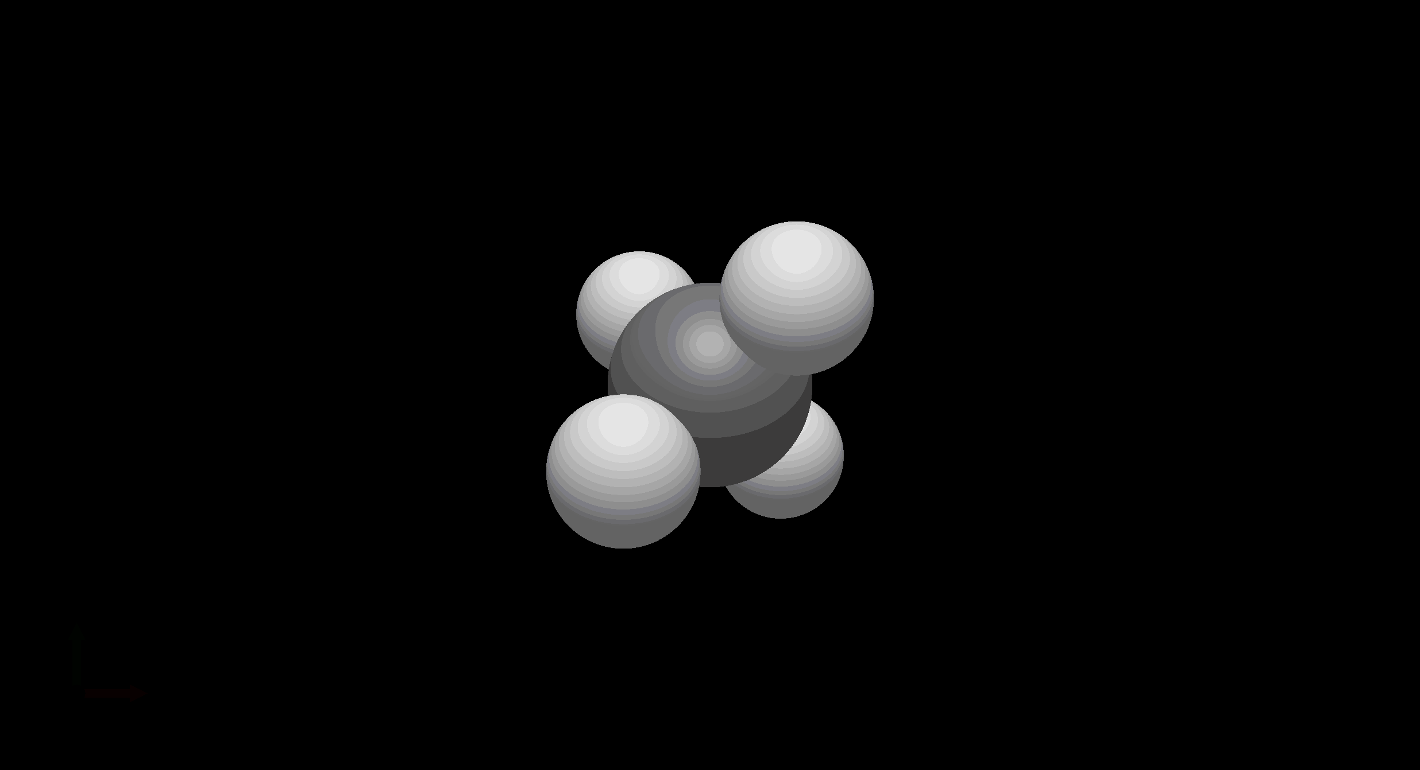
CH4 Mode 8

Slide 60
CH4 Mode 10

Slide 61
CH4 Mode 11

Slide 62
CH4 Mode 12

Slide 63
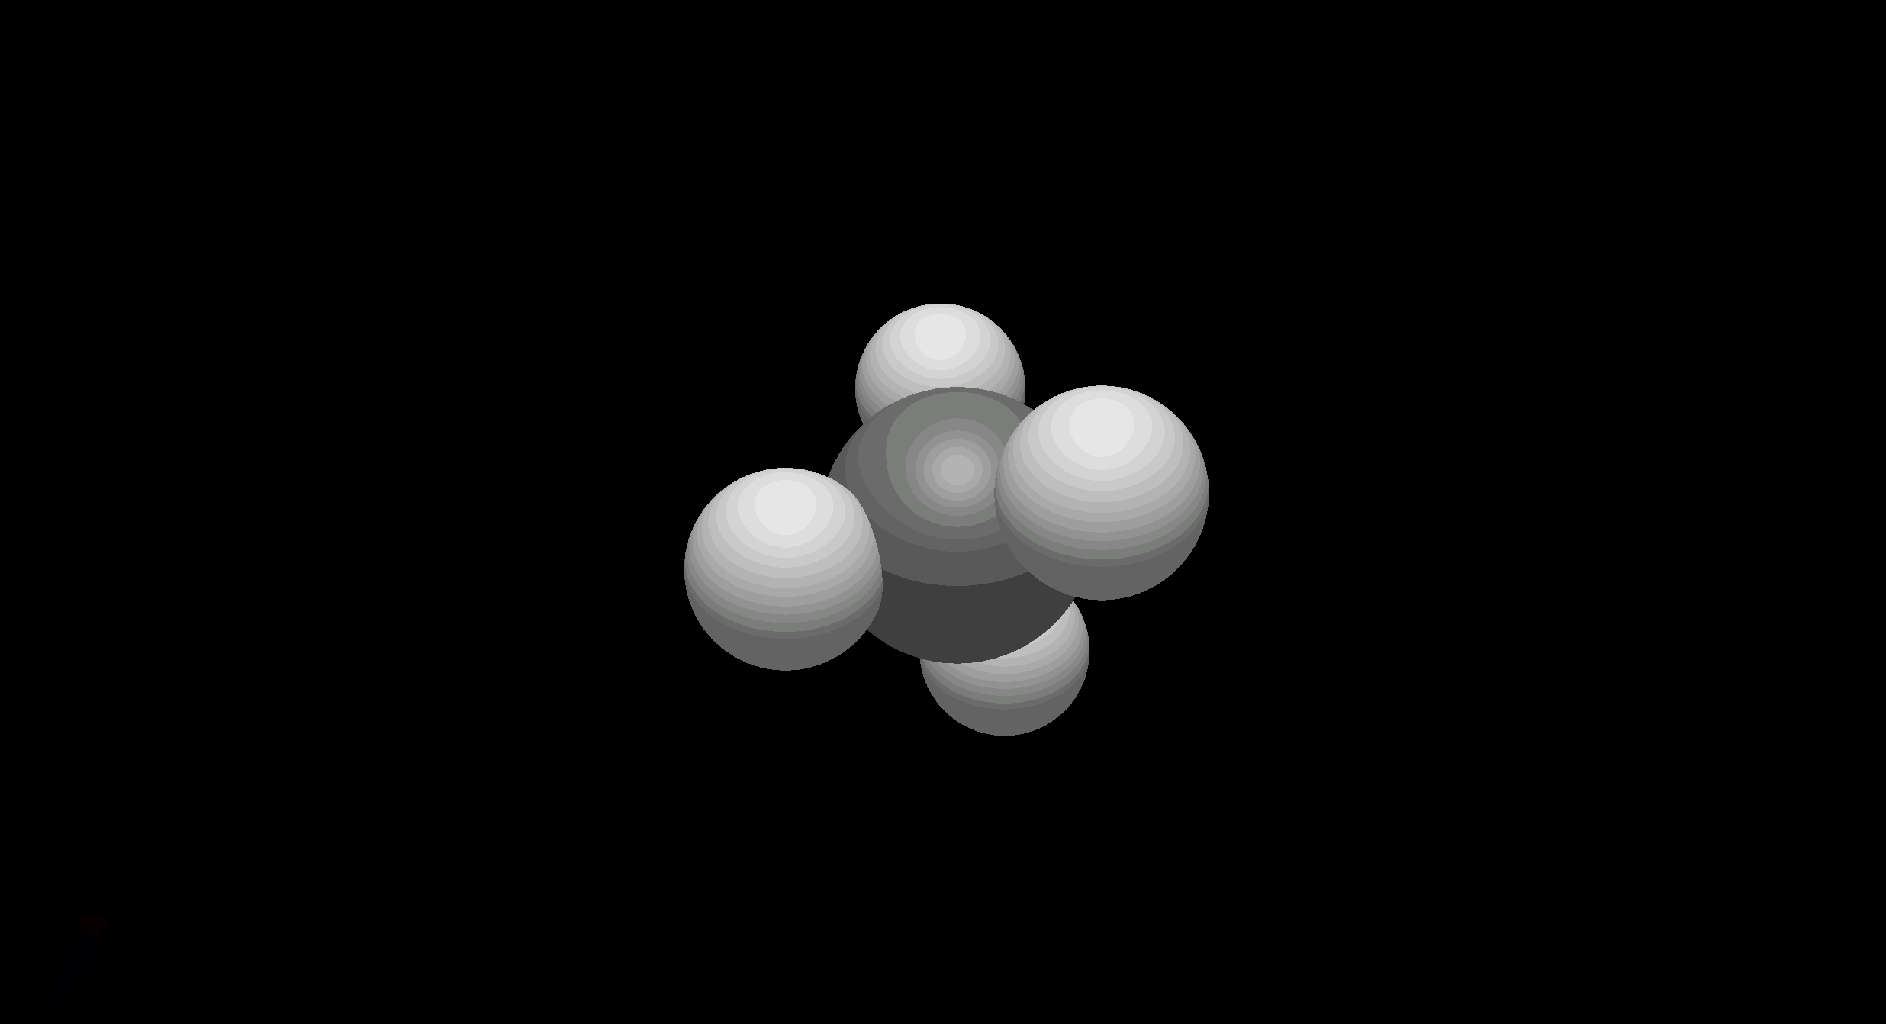
CH4 Mode 13

Slide 64
CH4 Mode 14

Slide 65
CH4 Mode 15

Slide 66
CH4 Mode 15 Van Der Waals

